Slide 1

Swedish Chamber of Commerce in China
Election Committee
2025 Board Proposal

Slide 2
Nominee | Representing | Position | Location | Gender | Industry
Elisabeth Lindström-Dupuy | Sandvik | Chairman | Beijing | Female | Industry
Joakim Diamant | Scania | Vice Chair (Beijing) | Beijing | Male | Industry
Tony Wang | Nordic Match | Vice Chair (Shanghai) | Shanghai | Male | Service
Johan Annell | ARC | Treasurer | Beijing | Male | Service
Thomas Zhao | SKF | Director | Shanghai | Male | Industry
Michel Qin Zhao | Volvo Cars | Director | Shanghai | Female | Industry
Hui Chen | IKEA Supply Area East Asia | Director | Shanghai | Female | Retail
Ola Källqvist | Celemi APAC | Director | Shanghai | Male | Service
Tomas Kuta | Volvo CE | Director | Shanghai | Male | Industry
Justin Zhou | Atlas Copco Group | Director | Shanghai | Male | Industry
Eileen Yan | Kreab | Director | Beijing | Female | Service
Per Rikard Olsson | Stena | Director | Weihai (Beijing) | Male | Shipping
 |  | 4 Office Bearers 8 Directors //12 | 7 Shanghai 5 Beijing //12 | 4 Female 8 Male //12 | 4 Service 6 Industry 1 Shipping 1 Retail //12

Slide 3
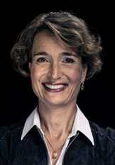
Mission Statement
As the chairman of the Swedish Chamber of Commerce in China, I will give my full support to the GM and her team, to reach their goals and visions. Through building bridges between both countries and companies, I want to contribute to a better understanding of business challenges and opportunities, helping Swedish companies to expand and succeed in China. I believe in collaboration as a pillar for both growth and innovation, hence my trust that the Swedish Chamber of Commerce in China can support member companies to a sustainable and continued development, in facilitating exchange between member companies, aiming to learn from each other. With my many years in China and extensive experience in the manufacturing industries, I believe and hope that the board members and I can fill the role of a sounding board to the GM and her team.
Elisabeth Lindström-Dupuy
Sandvik
Years in Board | Position | Previous Position
 | Chairman

Slide 4
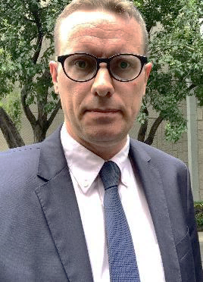
Mission Statement
With 20 years in China working with Swedish companies and serving at the Swedish Embassy in Beijing I will leverage my expericences to strengthen SwedCham’s role in today’s shifting geopolitical landscape. As the global dynamics evolve, I aim to ensure that the Board delivers strategic value to the Chamber and its members.
My deep understanding of Sino-Swedish business and diplomatic challenges positions me to help SwedCham remain relevant, resilient, and results-driven. I am committed to fostering collaboration and competitiveness for our members in this critical market to help the chamber and the member companies to further adapt and integrate to the Chinese business environment.
Joakim Diamant
Scania
Years in Board | Position | Previous Position
 | Vice chairman Beijing

Slide 5
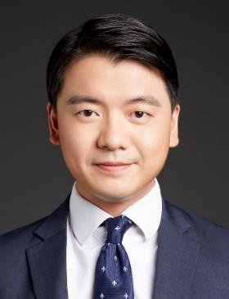
Mission Statement
Reflecting on my background as a Swedish with Chinese roots, I have long felt a strong mission to contribute to the Sino-Swedish community. As Swedcham is an integral meeting platform and growth promoter for Swedish businesses in China, the key focus of my candidacy at the Chamber will the following: 1) Help to increase the number of members by increasing the awareness of the Chamber both in China and Sweden 2) Engage Swedish corporate leaders to discuss and exchange strategic objectives through Swedcham network and hence secure the competitiveness of Swedish companies in China 3) Engage with the growing numbers of Swedish entrepreneurs in China and helping them to succeed.
Tony Wang
Nordic Match
Years in Board | Position | Previous Position
4 | Vice Chairman Shanghai | Vice Chairman Shanghai

Slide 6
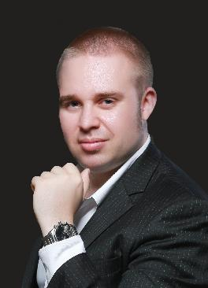
Mission Statement
I wish to contribute to the chamber growing in membership and impact for members, while also increasing the chamber’s relevance and influence beyond the Swedish Business community in China. I can contribute with network and knowledge from work on supply chain, growth strategy and cross border financing, where we as true cross-border specialists work with Chinese companies “going out” and foreign companies active in China.
By engaging further with Chinese young professionals, staff in member companies, entrepreneurs, large companies and media we can create direct member value and multiply the impact of the chamber, an exciting mission!
Johan Annell
ARC
Years in Board | Position | Previous Position
 | Treasurer

Slide 7
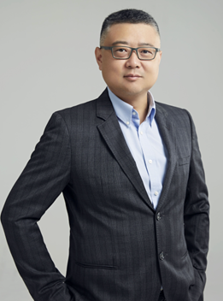
Mission Statement
Founded in 1907 in Gothenburg, SKF is a world-leading provider of innovative solutions that help our customers improve their rotating equipment performance and reduce their environmental impact. Our offering includes bearings, seals, lubrication management, condition monitoring, and services.
The world changes and the landscape is more competitive than ever which requires even stronger ties among the Swedish companies. Under the continuously evolving economic and geopolitical environments, I am committed to engage my passion, extensive legal & compliance background, network & practices in carbon neutral and ESG, and connections with various associations & organizations in contributing to the success of Swedish companies and Swedcham in China.
Tomas Zhao
SKF
Years in Board | Position | Previous Position
1 | Director | Director

Slide 8
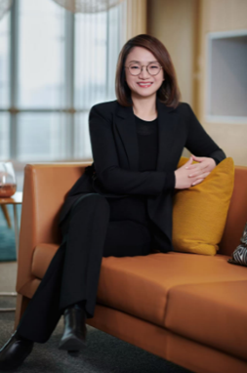
Mission Statement
As a dedicated advocate for Swedish excellence in China, my mission is to champion the growth and visibility of the Swedish brand while fostering a vibrant, interconnected community that elevates both business success and personal development. I aim to bridge Swedish innovation with China’s dynamic market by creating platforms for collaboration, knowledge-sharing, and cultural exchange.
I will prioritize strengthening SwedCham’s network to empower members through mentorship, strategic partnerships, and tailored resources that address evolving challenges. By amplifying Sweden’s reputation for sustainability, quality, and trust, I seek to unlock opportunities that benefit companies and individuals alike.
My commitment is to cultivate a supportive ecosystem where Swedish professionals and businesses not only thrive but also contribute meaningfully to Sino-Swedish relations. Together, we’ll build a legacy of resilience, mutual growth, and shared pride.
Michel Qin Zhao
Volvo Cars China
Years in Board | Position | Previous Position
4 | Director | Director

Slide 9
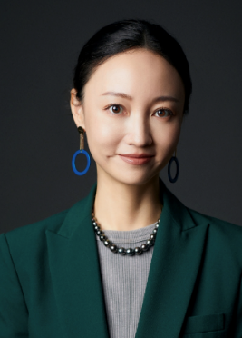
Mission Statement
In IKEA value chain, Supply Area East Asia (SAEA) covers two important stages: “Manufacture and improve” and “Package and distribute” for IKEA products. Hui Chen as President of IKEA SAEA, is responsible for creating, leading, and securing the legal operations and organisation to enable partnership between all Business units, and identifying efficiencies and synergies to address gaps and overlaps together with all Business units.
Hui Chen
IKEA Supply Area East Asia
Years in Board | Position | Previous Position
1 | Director | Director

Slide 10
Mission Statement
The Swedish Chamber of Commerce in China plays a pivotal role in supporting Swedish businesses in the Chinese market. As a board member, I aim to further enhance the Chamber’s influence through the following focus areas:
1. Promote a nuanced and informed perception of China in Sweden
The current debate in Sweden often presents a one-sided view of China. By establishing proactive communication strategies and working closely with Swedish media, I aim to contribute to a more balanced and fact-based discussion, highlighting Swedish companies’ positive experiences and the opportunities available in the Chinese market.
2. Strengthen representation of small and medium-sized member companies
The Chamber should serve as an inclusive platform where companies of all sizes feel heard and represented. I intend to implement initiatives that address the unique challenges and needs of smaller enterprises, which may include tailored networking events, mentorship programs, and capacity-building resources.
3. Enhance transparency, accountability, and member engagement
By introducing regular updates, open forums, and clear strategic guidelines, I aim to foster a culture of openness within the Chamber. This approach will not only strengthen members’ trust but also encourage active participation and shared ownership in the Chamber’s future.
With 17 years of experience living and working in China, coupled with a proven track record of founding and selling companies in Sweden, Europe, and China, I possess a deep understanding of the dynamic challenges and opportunities that Swedish businesses encounter internationally. My expertise in international business development, strategic communication, and leadership, particularly in my role at Celemi APAC & China, equips me with the skills and network necessary to contribute positively to the Chamber’s growth.
I look forward to the opportunity to collaborate with members and the board to further develop the Chamber’s role as a catalyst for successful Swedish-Chinese business relations and to strengthen the dialogue between our nations.
Ola Källqvist
Celemi APAC
Years in Board | Position | Previous Position
 | Director

Slide 11
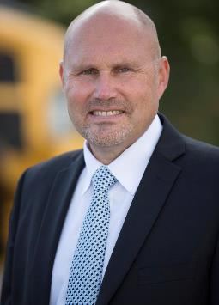
Mission Statement
SwedCham’s activities should focus on supporting Swedish companies to establish themselves in China, promote Sweden as a targeted country for investors from China, but also and not least to help educate and lobby in Sweden and China regarding true business climate, accurate political situation in both countries and help Swedish companies to understand the necessity of accessing China’s outstanding supply chain and technological capabilities. There is a great potential and opportunities for Swedish companies to establish operations in China which will develop and strengthen their capabilities and help them to become competitive and innovative in cooperation in global markets.
Tomas Kuta
Volvo CE
Years in Board | Position | Previous Position
 | Director

Slide 12
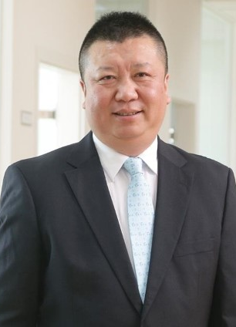
Mission Statement
My mission is to build up and implement development strategy in China, deliver customer value by developing, offering and delivering the smart assembly solution to Chinese manufacturers, maintain our market leader position in China market through speeding up and scaling up “Local for Local” strategy and digitalization transformation, also to drive future-proof organization transformation through people and culture initiatives.
I have been working as SwedCham Shanghai Committee members since 2023. I am really happy and feel proud to be part of this great team. I would like to apply for the Ordinary Member of the SwedCham Board. I am really looking forward to have the chance to contribute more to SwedCham through enhancing the network with members, implementing our strategy with effective and efficient activities, maintaining strong connection with key stakeholders, supporting the member companies to better sharing the best experiences and further developing strong positions in China. I am committed to participating the meetings and activities of SwedCham Board.
Justin Zhou
Atlas Copco Group
Years in Board | Position | Previous Position
 | Director

Slide 13
Mission Statement
Representing Kreab, Eileen aspires to join the SwedCham board to contribute her energy, expertise, and extensive network in support of the chamber’s continued growth and impact. With her deep understanding of the China market and strong connections across industries, she aims to help SwedCham further enhance its influence among its members and strengthen its presence in the local business landscape. Through strategic initiatives, meaningful engagements, and knowledge-sharing, she is committed to fostering a more dynamic and value-driven community for SwedCham members.
Eileen Yan
Kreab
Years in Board | Position | Previous Position
 | Director

Slide 14
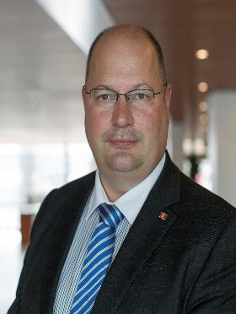
Mission Statement
As a candidate for the Swedish Chamber of Commerce Board, my mission is to drive sustainable growth, innovation, and collaboration within the business community. I aim to strengthen ties between Swedish and Chinese enterprises, fostering trade, investment, and knowledge exchange.
By leveraging my expertise as Swedish Citizen with more than 15 years living and working in China in Marine and production sector, I will advocate for enhanced collaboration, digital transformation, and ethical business practices. My commitment is to support member companies through strategic networking, mentorship, and impactful initiatives that align with Sweden’s values of inclusivity and sustainability. To develop and contribute positively to SwedCham will be a pleasure.
Per Rikard Olsson
Stena
Years in Board | Position | Previous Position
 | Director

