Slide 1
Swedish Chamber of Commerce in China Election Committee
2024 Board Proposal

Slide 2
2024
Nominee | Representing | Position | Location | Gender | Industry
Ludvig Nilsson | Jade Invest | Chairman | Shanghai | Male | Service
Sara Wramner | Honorary Member | Vice Chair BJ | Beijing | Female
Tony Wang | Nordic Match | Vice Chair SH | Shanghai | Male | Service
Karen Xu | White Peak | Treasurer | Beijing | Female | Service
Kevin Zhang | Swedbank | Director | Shanghai | Male | Bank
Thomas Zhao | SKF | Director | Shanghai | Male | Industry
Hui Chen | INTER IKEA | Director | Shanghai | Female | Retail
Martin Poxton | Assa Abloy | Director | Shanghai | Male | Industry
Martin Zachrisson | Etteplan | Director | Suzhou | Male | Service
Michel Zhao Qin | Volvo Cars | Director | Shanghai | Female | Industry
Aiying Wang | Envac | Director | Shanghai | Female | Industry
Simon Cai | Triple Digit | Director | Shanghai | Male | Service
Daniela Ling-Vannerus | Swedcham | GM | Beijing | Female | Service
 |  | 4 Office Bearers 8 Directors 1 General Manager //13 | 9 Shanghai 3 Beijing 1 Suzhou //13 | 6 Female 7 Male //13 | 6 Service 4 Industry 1 Retail 1 Bank 1 Other //13

Slide 3
Background
Ludvig co-founded the private equity firm Jade Invest in 2005 in Shanghai. In his current capacity, Ludvig is responsible for overseeing day-to-day activities of the firm’s Shanghai office, including investment management, investor relations and internal operations, as well as several board directorships in Jade’s investments. Ludvig’s previous experience includes PwC Transaction Services Strategy Group (London), Roland Berger Strategy Consultants (Shanghai) and Longshine Technology (Beijing & Shanghai).
Ludvig holds a BA in Chinese and Management from The School of Oriental and African Studies (SOAS), University of London, and is a fluent Mandarin speaker.
Ludvig has been the Chairman of the Board of Directors of the Swedish Chamber of Commerce in China since 2021.
Mission Statement I first arrived in China 25 years ago and have lived in China for over 20 years. For most of my time here, I have focused on gaining a deep understanding of the local market and how Chinese companies are developing. I would like to bring this experience to Swedish companies, to help them develop better in China. This means finding ways to sharpen the tools to compete effectively with leading local companies in China, as well as finding win-win partnerships with Chinese companies for the Chinese and international markets.
I also think the chamber has an important role in helping Chinese employees in Swedish companies to understand Swedish culture, communication and leadership style as well as values. This is important to help Swedish companies attract and motivate the best talent as well as building support for the Sweden brand
Ludvig Nilsson
Jade Invest
Years in Board | Position | Previous Position
3 | Suggesting re-election as Chairman of the Board | Chairman of the Board

Slide 4
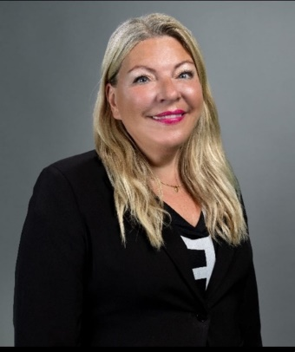
Mission Statement
China today is a very different market and society than just a couple of years ago, so with new mindset, ideas and some creativity SCCC can further increase the value for its current members as well as to reach new potential areas and resources.
With my almost 3 decades of senior business experience in China, my fluent Chinese, and my drive and passion to be the link between East and West, I am convinced we can make SCCC even more brilliant and successful, as well as further improve Sino-Swedish business relations and promoting the Swedish brand and image.
Sara Wramner
Honorary Member
Years in Board | Position | Previous Position
New | Suggesting election as Vice Chairman Beijing
Mission Statement
Reflecting on my background as a Swedish with Chinese roots, I have long felt a strong mission to contribute to the Sino-Swedish community. As Swedcham is an integral meeting platform and growth promoter for Swedish businesses in China, the key focus of my candidacy at the Chamber will the following: 1) Help to increase the number of members by increasing the awareness of the Chamber both in China and Sweden 2) Engage Swedish corporate leaders to discuss and exchange strategic objectives through Swedcham network and hence secure the competitiveness of Swedish companies in China 3) Engage with the growing numbers of Swedish entrepreneurs in China and helping them to succeed.
Tony Wang
Nordic Match
Years in Board | Position | Previous Position
3 | Suggesting re-election as as Vice Chairman Shanghai | Vice Chairman Shanghai

Slide 5
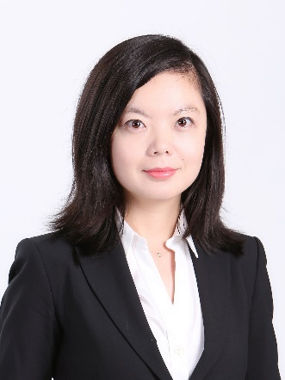
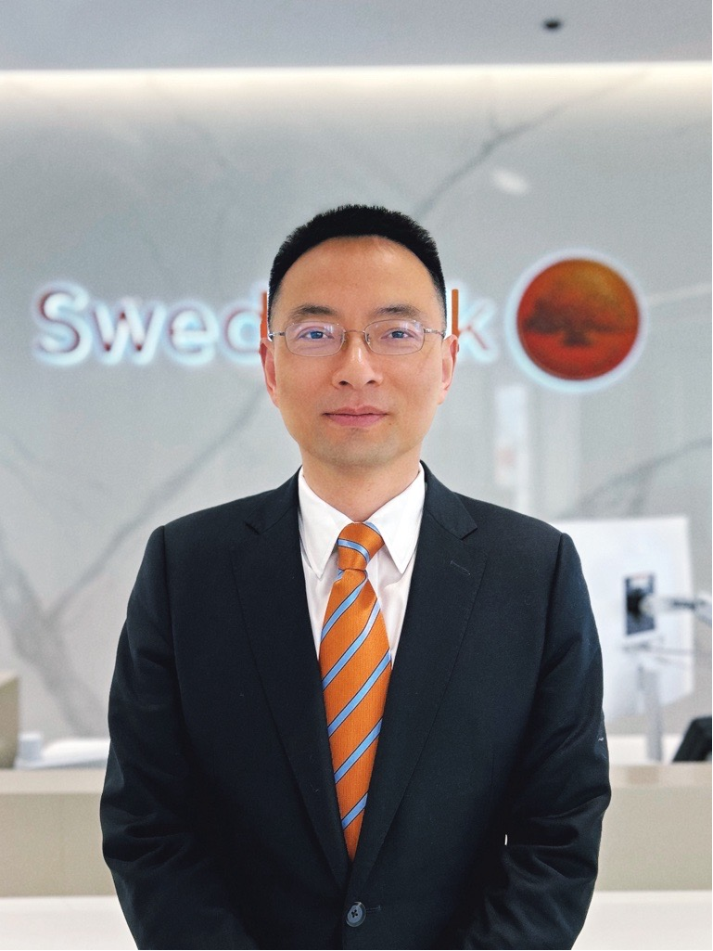
Mission Statement I was deeply involved in promoting the sustainability values especially the Swedish Hammarby Eco City model in China. I’m also a member of the Beijing Chapter Board of the Swedish Chamber and acted as the National Vice Chair of the Construction Working Group of the European Union Chamber of Commerce in China.
I have developed deep understandings on the realities Swedish businesses are faced with as well as the opportunities they have in China. I think my passion, knowledge and network could be a valuable addition to the Main Board on certain aspects including strengthening the collaboration and sharing among members as well as promoting sustainability in China and internationally.
Karen Xu
White Peak
Years in Board | Position | Previous Position
2 | Suggesting re-election as Treasurer | Treasurer
Mission Statement Swedbank Shanghai is a corporate silver partner of SwedCham China. I joined the bank 23 years ago and have had the opportunity to work closely with Swedish companies to expand their business in China. This has provided me with profound knowledge of the challenges and opportunities that Swedish businesses face in the Chinese market. I am confident that my understanding of these issues, coupled with my banking background, will contribute significantly to SwedCham China's objectives. As a board member, I will be committed to attending the bi-monthly board meetings, leveraging my network, and contributing my insights to further enhance the chamber's value to its members.
Kevin Zhang
Swedbank
Years in Board | Position | Previous Position
New | Suggesting election as Director | -

Slide 6
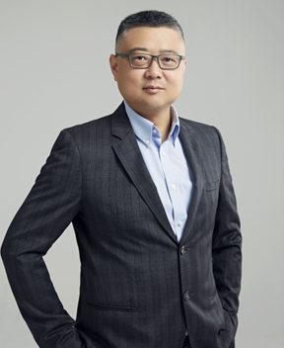
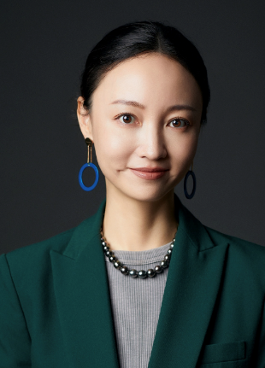
Mission Statement
SKF is a world-leading provider of innovative solutions that help our customers improve their rotating equipment performance and reduce their environmental impact. Our offering includes bearings, seals, lubrication management, condition monitoring, and services. Founded in 1907, SKF is represented in approximately 130 countries and willing to contribute to “improve Sino-Swedish business ties and promote the Swedish brand”.
The world changes and the landscape is more competitive than ever which requires even stronger ties among the Swedish companies. I am committed to engage my passion, extensive legal & compliance background and knowledge and practices in carbon neutral and ESG in contributing to the success of Swedcham and Swedish companies in China.
Tomas Zhao
SKF
Years in Board | Position | Previous Position
New | Suggesting election as Director | -
Mission Statement
Based on my experiences on industry and business, I strongly believe that the circular economy will be the future focus of business development. Therefore, I make dedicated efforts on leading company towards a transition to circular business. Along this journey, I also found that – breaking boundaries and constraints, through cross-industry collaborations and diversified partnerships, we can contribute to the protection of ecosystem, as well as create sustainable value for the company and colleagues.
Additionally, in the ever-changing times, I also hope to leverage my understanding of women’s leadership to support others to continuously moving forward amidst uncertainty. I am also committed to utilizing my social network to create value for the Swedish business community, expand the relationship between Swedish companies and Chinese & international companies across industries. By fostering these collaboration and communication, I hope to help enhance the influence of the Swedish business community, bring diverse and international business insights to Swedish companies.
Hui Chen
Inter IKEA
Years in Board | Position | Previous Position
New | Suggesting election as Director | Director

Slide 7
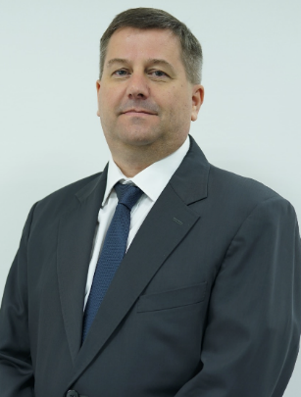
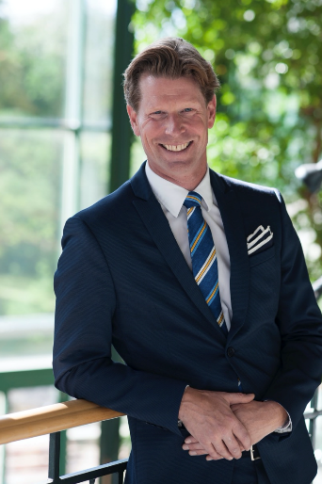
Mission Statement
As a Board of the Shanghai Swedish Chamber of Commerce, I have actively fulfilled my duties, participated in many Chamber activities, and strengthen the Swedish Chamber's unity and impact through my own and organizational influence. If I am elected to the Board of the Swedish Chamber of Commerce in China, I will be obliged to take up the responsibility of developing the Chamber, providing more opportunities to connect the Chamber with business and government, assisting SwedCham China to consistently enhance business exchange between China and Sweden, to create new business opportunities for Swedish enterprises, and to make greater contributions to improve Sino-Swedish business ties and promote the Swedish brands.
Martin Poxton Assa Abloy
Years in Board | Position | Previous Position
1 | Suggesting re-election as Director | Director
Mission Statement
In the quickly changing China business environment the need for SwedCham not only as a platform for information and social events, but as community and common voice grows even more evident. I believe I have the engagement, skills and network to contribute in a number of areas. I’d like to focus on hands-on services of high value for members, addressing issues that many Swedish companies’ operation in China encounter, maybe even more so SME businesses. I’d like to represent a service company perspective. I hope to see SwedCham grow as a highly valued networking hub also outside BJ/SHA. Regarding social activities I’d like to add sport events to the portfolio.
Martin Zachrisson
Etteplan
Years in Board | Position | Previous Position
1 | Suggesting re-election as Director | Director

Slide 8
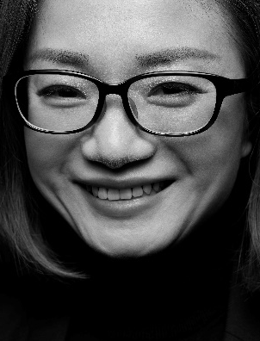
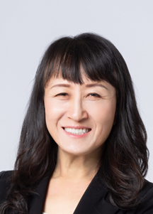
Mission Statement
We can provide more value-added activities to members for best practice sharing and connect companies who wants to learn each other more proactively; we can do a better membership management by utilizing China’s fast growing digital technology and making sure we know the needs from various background members and match it with the needed knowledge or activities; we shall create national initiatives given our network with government, business sector and our business nature to improve influence power of Swedish Brands in China in a more proactive and impactful way.
Michel Qin Zhao
Volvo Cars Asia-Pacific
Years in Board | Position | Previous Position
3 | Suggesting re-election as Director | Director
Mission Statement If I became a board member for SwedCham, I would actively seek for ways to multiply our diversified experience in various industries to share best practices and lessons learned to help one another to thrive in local market. With my experience as the Chair for AmCham Suzhou, I would join with others to proactively build relationship with local government to promote healthy competition and improve / enable mutually beneficial business environment. This is an era for collaboration, we can form productive consortium with other chambers and organizations to enlarge influencing momentum with local decision makers. In addition, I hope to inspire women to maximize potentials for business leadership and / or not afraid to step into STEM field.
Aiying Wang
Envac Environment Technology
Years in Board | Position | Previous Position
2 | Suggesting re-election as Director | -

Slide 9
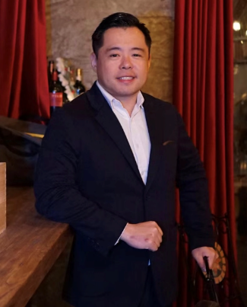
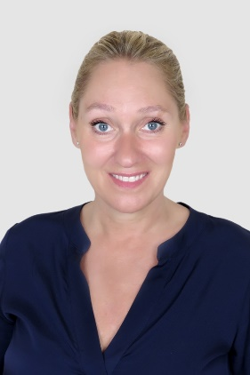
Mission Statement
As a Swedish Chinese with 10+ years experience working with China, I am able to support the members to solve problems in China using my network. I am fluent in Mandarin, Swedish and English. My company Triple Digit is an e- commerce partner that helps Nordic brands to sell online in China. Today we help Swedish companies such as Daniel Wellington, Eytys and Maria Nila.
I will help develop the Swedcham E-commerce Network. This initiative has attracted many Swedish companies in the growing consumer sector including Toteme, Acne Studios, Eytys, H&M etc. By maintaining an active network, many of them will join as members of Swedcham.
Simon Cai
Triple Digit
Years in Board | Position | Previous Position
1 | Suggesting re-election as Director | Director
Daniela started as the General Manager of Swedcham China on September 1st 2019, and have now lived in Beijing for the last 8,5 years. Daniela has a MBA in International Business from Schiller International University in Paris, where she lived for 12 years. After an extensive experience within Media, where Daniela was working for numerous well known Newspapers and Media houses, she followed with her husband to China in 2016 as new family adventure. Daniela have used her time before joining the Chamber to learn Mandarin, reaching HSK 4 level in only 2 years, and is currently preparing for the HSK 5 level. Danielas family consists of husband, 3 children, and a Giant Schnauzer dog named Steffi and they all live in Chaoyang in Beijing.
Daniela Ling-Vannerus General Manager
Swedish Chamber of Commerce in China
Years in Board | Position | Previous Position
5 | GM | GM

